Slide 1

P peline
The Data
Byte 6: Big Data
© Jennifer Mankoff
The Data Pipeline; HCII; Spring 2014

Slide 2
I struggled to define this
Hadoop and Hive not much use on a single machine
Setting up a full multi-machine pipeline and playing with it could take a semester (and is costly!)
I discarded AWS months ago…

Slide 3
Google BigQuery
Lets us explore how we might use Big Data once it is loaded onto an appropriate infrastructure
Ties in nicely to Google Appspot

Slide 4
The Data Set
There are a number of public data sets on BigQuery. You can use any of them
We focus on the natality data set
https://cloud.google.com/bigquery/docs/dataset-natality
“All births registered in the 50 States, DC, and NYC from 1969 to 2008. The CDC receives these data as electronic files, prepared from individual records processed by each registration area…”

Slide 5
Goal 1
Simple queries using Google Big Query’s version of SQL (pretty complete)
Explore the data, develop a nice app showing it off
Read up to understand how to work with your own data

Slide 6
Setup
Install Google Cloud SDK (if you haven’t already)
Get the command line working to test things

Slide 7
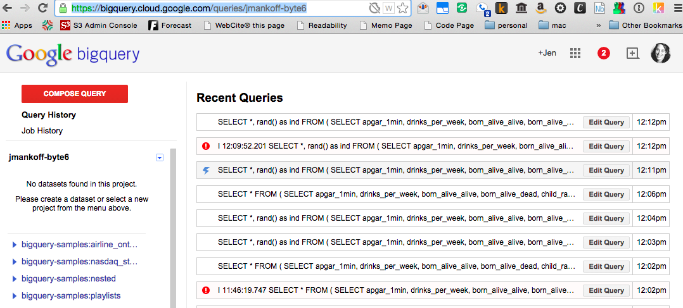
You can also test things on the web
https://bigquery.cloud.google.com/queries/jmankoff-byte6
SELECT state, count(*) FROM [publicdata:samples.natality] GROUP by state
Notes:
Demonstrate….

Slide 8
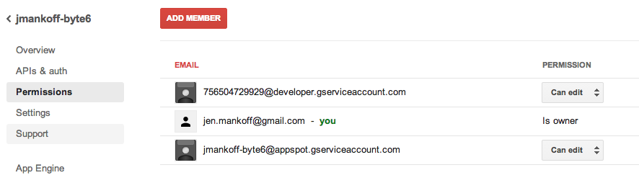
You will need to set permissions

Slide 9
You will need to set permissions
This project number is critical. You need it in your code

Slide 10
Debugging hints
Have to run most of this on appspot (sorry, plan for slow debug cycles)
It helps to create temporary data files on disk that you can just load (I explain one way to do this in the byte)

Slide 11
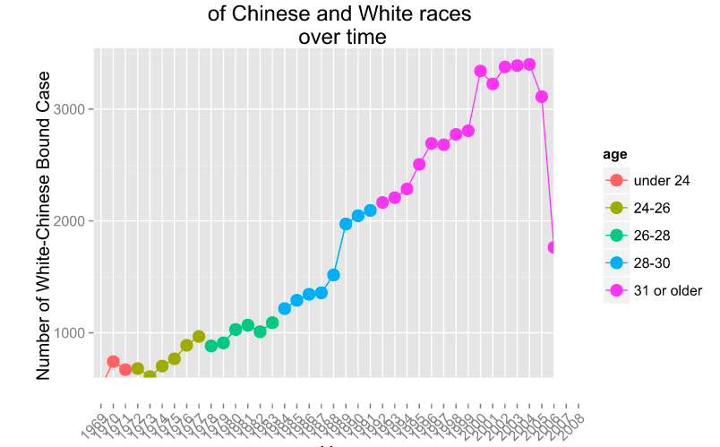
Sample Results

Slide 12
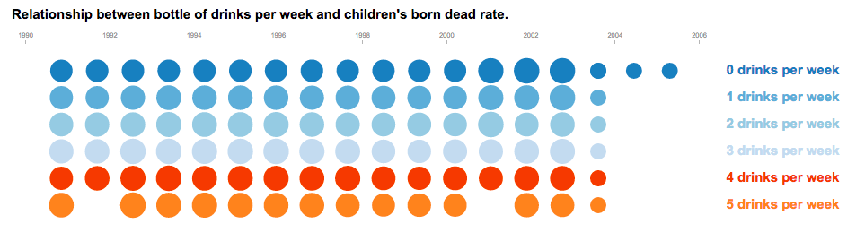
Sample Results

Slide 13
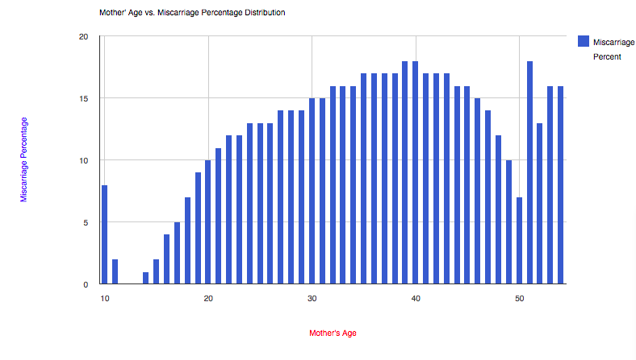
Sample Results

Slide 14
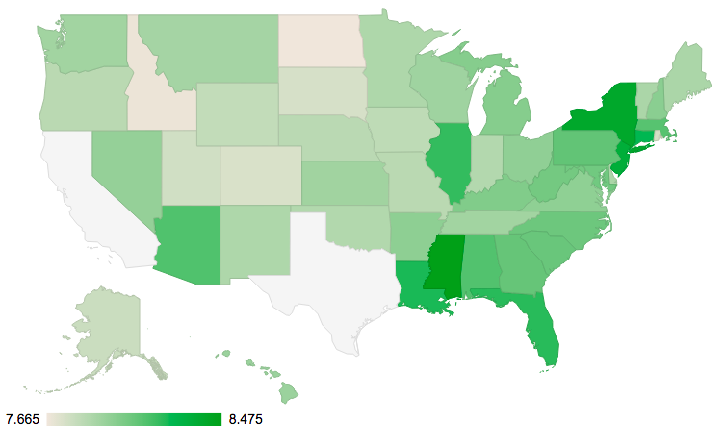
Sample Results
APGAR Baby Health Score in USA 1990 - 2004

Slide 15
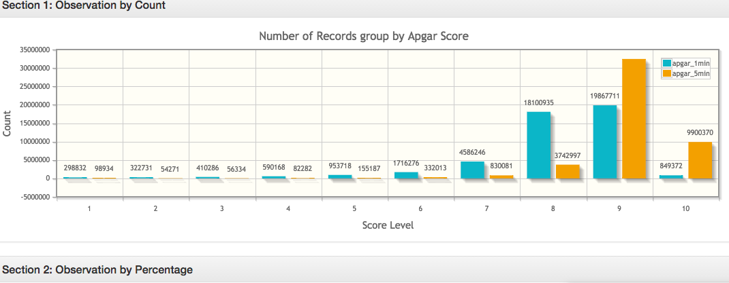
Sample Results
http://runyunz-byte6.appspot.com/

Slide 16
Goal 2
Develop an understanding of logistic regression’s gradient descent, and its stochastic version for larger data
Working (again) to improve accuracy
Developing a simple rule based learner
Calculating metrics
Show the result in an intelligible manner
If you are comfortable with Ajax, make it interactive…

Slide 17
Goal of Machine Learning
Predict the health of a baby being born
Apgar >= 7 vs Apgar <7
What are some good features?
Let’s look at the Natality Data Set

Slide 18
Natality Data Set
Field Name | Type | Description
alcohol_use | BOOL | True if the mother used alcohol. Available starting 1989
apgar_1min | INT | Apgar scores measure the health of a newborn child on a scale from 0-10. Value after 1 minute. Available from 1978-2002.
apgar_5min | INT | Apgar scores measure the health of a newborn child on a scale from 0-10. Value after 5 minutes. Available from 1978-2002.
born_alive_alive | INT | Number of children previously born to the mother who are now living.
born_alive_dead | INT | Number of children previously born to the mother who are now dead.
…

Slide 19
Natality Data Set
…
Field Name | Type | Description
plurality | INT | How many children were born as a result of this pregnancy. twins=2, triplets=3, and so on.
state | STR | The two character postal code for the state. Entries after 2004 do not include this value.
wday | INT | Day of the week, where 1 is Sunday and 7 is Saturday.
weight_gain_pounds | FLOAT | Number of pounds gained by the mother during pregnancy.
weight_pounds | FLOAT | Weight of the child, in pounds.
year | INT | Four-digit year of the birth. Example: 1975.
https://cloud.google.com/bigquery/docs/dataset-natality
Notes:
Discuss how to pick appropriate features and talk about some of these and whether or not they are ok to use…

Slide 20
Example results
drinks_per_week : 10.4458435228
born_alive_alive : 5.10540437526
born_alive_dead : 0.201596177591
father_age : 158.603348865
mother_age : 145.833818566
weight_gain_pounds : 145.577879963
year : 9944.99904843
… [I had other features too in this]
accuracy : 0.91249999999999998
Notes:
Discuss year
Discuss variations among these features
Discuss accuracy …

Slide 21
Main algorithm
# weights -- the list weights currently assigned to the features (an empty array that will be filled in by this function. # X -- the array containing cases to predict from, # labels -- the ground truth y values. # step -- the rate controller for changing the weights. # lam -- the regularization parameter. Something you could play with on a large data set is what value to use for this. you would want to do that by picking an optimization set and trying lots of lam values (from 0 to 1) on that optimization set. # iterations -- defaults to 1 for stochastic gradient descent, but can be higher in standard gradient descent.
def gradient_descent(self, weights, X, y_labels, step=0.1, lam=0.1, iterations=1): m, n=X.shape # iterate over the rows to train the model on the same data for i in xrange(iterations): for r in xrange(_MAX_ROWS): old_weights = weights weights = old_weights + step*(self.loss_func(X[r], old_weights - y_labels[r]))*X[r] #add in regularization term weights = weights - lam*2.*step*old_weights return weight

Slide 22
Main algorithm
# weights -- the list weight scurrently assigned to the features (an empty array that will be filled in by this function. # X -- the array containing cases to predict from, # labels -- the ground truth y values. # step -- the rate controller for changing the weights. # lam -- the regularization parameter. Something you could play with on a large data set is what value to use for this. you would want to do that by picking an optimization set and trying lots of lam values (from 0 to 1) on that optimization set. # iterations -- defaults to 1 for stochastic gradient descent, but can be higher in standard gradient descent.
def gradient_descent(self, weights, X, y_labels, step=0.1, lam=0.1, iterations=1): m, n=X.shape # iterate over the rows to train the model on the same data for i in xrange(iterations): for r in xrange(_MAX_ROWS): old_weights = weights weights = old_weights + step*(self.loss_func(X[r], old_weights - y_labels[r]))*X[r] #add in regularization term weights = weights - lam*2.*step*old_weights return weight
We are using a fairly ‘dumb’ decision about when to stop here

Slide 23
Main algorithm
# weights -- the list weight scurrently assigned to the features (an empty array that will be filled in by this function. # X -- the array containing cases to predict from, # labels -- the ground truth y values. # step -- the rate controller for changing the weights. # lam -- the regularization parameter. Something you could play with on a large data set is what value to use for this. you would want to do that by picking an optimization set and trying lots of lam values (from 0 to 1) on that optimization set. # iterations -- defaults to 1 for stochastic gradient descent, but can be higher in standard gradient descent.
def gradient_descent(self, weights, X, y_labels, step=0.1, lam=0.1, iterations=1): m, n=X.shape # iterate over the rows to train the model on the same data for i in xrange(iterations): for r in xrange(_MAX_ROWS): old_weights = weights weights = old_weights + step*(self.loss_func(X[r], old_weights - y_labels[r]))*X[r] #add in regularization term weights = weights - lam*2.*step*old_weights return weight
This is the key aspect of the algorithm – updating the weights

Slide 24
Main algorithm
# weights -- the list weight scurrently assigned to the features (an empty array that will be filled in by this function. # X -- the array containing cases to predict from, # labels -- the ground truth y values. # step -- the rate controller for changing the weights. # lam -- the regularization parameter. Something you could play with on a large data set is what value to use for this. you would want to do that by picking an optimization set and trying lots of lam values (from 0 to 1) on that optimization set. # iterations -- defaults to 1 for stochastic gradient descent, but can be higher in standard gradient descent.
def gradient_descent(self, weights, X, y_labels, step=0.1, lam=0.1, iterations=1): m, n=X.shape # iterate over the rows to train the model on the same data for i in xrange(iterations): for r in xrange(_MAX_ROWS): old_weights = weights weights = old_weights + step*(self.loss_func(X[r], old_weights - y_labels[r]))*X[r] #add in regularization term weights = weights - lam*2.*step*old_weights return weight
Here’s where we use the loss function to decide how that update should happen . We provide that for you as well.
# loss function for logistic regression def loss_func(self, x, weights):
return 1.0 (1.+math.e**(-1.0*np.dot(x,weights)))

Slide 25
Stochastic Version
def stochastic_gradient_descent(self, features, predict, prediction_test, zeros_string, ones_string, batch=10):
weights = np.random.random(len(features)+1)
# Technically, we would do only one x at each round, but we can load subsets of the data and do multiple rows at each round. _MAX_ROWS determines how much data is loaded at each iteration. for i in xrange(batch):
# get _MAX_ROWS of examples of bad births and good births (equal amounts of each). This is so we have lots of examples of both types bad_births, bad_births_labels = self.get_data(features, predict, prediction_test, zeros_string) good_births, good_births_labels = self.get_data(features, predict, prediction_test, ones_string)
# combine them into one data set y_labels = np.concatenate([bad_births_labels, good_births_labels]) X = np.concatenate([bad_births, good_births])
# the resulting weights weights = self.gradient_descent(weights, X, y_labels)
model = lambda x: 1-self.loss_func(x, weights)<.5
return weights, model

Slide 26
Stochastic Version
def stochastic_gradient_descent(self, features, predict, prediction_test, zeros_string, ones_string, batch=10):
weights = np.random.random(len(features)+1)
# Technically, we would do only one x at each round, but we can load subsets of the data and do multiple rows at each round. _MAX_ROWS determines how much data is loaded at each iteration. for i in xrange(batch):
# get _MAX_ROWS of examples of bad births and good births (equal amounts of each). This is so we have lots of examples of both types bad_births, bad_births_labels = self.get_data(features, predict, prediction_test, zeros_string) good_births, good_births_labels = self.get_data(features, predict, prediction_test, ones_string)
# combine them into one data set y_labels = np.concatenate([bad_births_labels, good_births_labels]) X = np.concatenate([bad_births, good_births])
# the resulting weights weights = self.gradient_descent(weights, X, y_labels)
model = lambda x: 1-self.loss_func(x, weights)<.5
return weights, model
How many times to loop. The default is small for debugging purposes.
Notes:
needs to run repeatedly, pulling new data each time
it incorporates calls to get_data inside its loop and it needs
batch is the number of times to run this (make it small when debugging)

Slide 27
Stochastic Version
def stochastic_gradient_descent(self, features, predict, prediction_test, zeros_string, ones_string, batch=10):
weights = np.random.random(len(features)+1)
# Technically, we would do only one x at each round, but we can load subsets of the data and do multiple rows at each round. _MAX_ROWS determines how much data is loaded at each iteration. for i in xrange(batch):
# get _MAX_ROWS of examples of bad births and good births (equal amounts of each). This is so we have lots of examples of both types bad_births, bad_births_labels = self.get_data(features, predict, prediction_test, zeros_string) good_births, good_births_labels = self.get_data(features, predict, prediction_test, ones_string)
# combine them into one data set y_labels = np.concatenate([bad_births_labels, good_births_labels]) X = np.concatenate([bad_births, good_births])
# the resulting weights weights = self.gradient_descent(weights, X, y_labels)
model = lambda x: 1-self.loss_func(x, weights)<.5
return weights, model
We need new labels and rows each time we loop. self.get_data retrieves data from big_query for us

Slide 28
get_data
# a helper function for retrieving data from the database and putting it into # the right format for machine learning. def get_data(self, features, predict, prediction_test, filter=None, limit=_MAX_ROWS):
# need to retrieve data from bigquery query_string = self.make_query_string(features, predict, filter, limit)
…
# y are the labels -- the values we are predicting y = np.array(labels)
# X are the features -- the values we use to make the prediction X = np.array(data)
return X, y

Slide 29
get_data
# a helper function for retrieving data from the database and putting it into # the right format for machine learning. def get_data(self, features, predict, prediction_test, filter=None, limit=_MAX_ROWS):
# need to retrieve data from bigquery query_string = self.make_query_string(features, predict, filter, limit)
…
# y are the labels -- the values we are predicting y = np.array(labels)
# X are the features -- the values we use to make the prediction X = np.array(data)
return X, y
get_data returns two variables: A vector of labels, and an array of values.

Slide 30
get_data
get_data depends on make_query_string
# a helper function for retrieving data from the database and putting it into # the right format for machine learning. def get_data(self, features, predict, prediction_test, filter=None, limit=_MAX_ROWS):
# need to retrieve data from bigquery query_string = self.make_query_string(features, predict, filter, limit)
…
# y are the labels -- the values we are predicting y = np.array(labels)
# X are the features -- the values we use to make the prediction X = np.array(data)
return X, y

Slide 31
get_data
get_data depends on make_query_string
# a helper function for retrieving data from the database and putting it into # the right format for machine learning. def get_data(self, features, predict, prediction_test, filter=None, limit=_MAX_ROWS):
# need to retrieve data from bigquery query_string = self.make_query_string(features, predict, filter, limit)
…
# y are the labels -- the values we are predicting y = np.array(labels)
# X are the features -- the values we use to make the prediction X = np.array(data)
return X, y
make_query_string constructs a query string out of the features

Slide 32
get_data
get_data depends on make_query_string
# a helper function for retrieving data from the database and putting it into # the right format for machine learning. def get_data(self, features, predict, prediction_test, filter=None, limit=_MAX_ROWS):
# need to retrieve data from bigquery query_string = self.make_query_string(features, predict, filter, limit)
…
# y are the labels -- the values we are predicting y = np.array(labels)
# X are the features -- the values we use to make the prediction X = np.array(data)
return X, y
make_query_string constructs a query string out of the features, class to be predicted

Slide 33
get_data
get_data depends on make_query_string
# a helper function for retrieving data from the database and putting it into # the right format for machine learning. def get_data(self, features, predict, prediction_test, filter=None, limit=_MAX_ROWS):
# need to retrieve data from bigquery query_string = self.make_query_string(features, predict, filter, limit)
…
# y are the labels -- the values we are predicting y = np.array(labels)
# X are the features -- the values we use to make the prediction X = np.array(data)
return X, y
make_query_string constructs a query string out of the features, class to be predicted, and a filter (for things unwanted)

Slide 34
get_data
get_data depends on make_query_string
# a helper function for retrieving data from the database and putting it into # the right format for machine learning. def get_data(self, features, predict, prediction_test, filter=None, limit=_MAX_ROWS):
# need to retrieve data from bigquery query_string = self.make_query_string(features, predict, filter, limit)
…
# y are the labels -- the values we are predicting y = np.array(labels)
# X are the features -- the values we use to make the prediction X = np.array(data)
return X, y
make_query_string constructs a query string out of the features, class to be predicted, and a filter (for things unwanted), limited to [limit] rows of results.

Slide 35
get_data
get_data depends on make_query_string
# a helper function for retrieving data from the database and putting it into # the right format for machine learning. def get_data(self, features, predict, prediction_test, filter=None, limit=_MAX_ROWS):
# need to retrieve data from bigquery query_string = self.make_query_string(features, predict, filter, limit)
…
# y are the labels -- the values we are predicting y = np.array(labels)
# X are the features -- the values we use to make the prediction X = np.array(data)
return X, y
An example filter is: "row_number % 2 = 1 AND apgar_1min < 7”
The first part of this specifies that we only use odd rows (for training) and the second part specifies the apgar values should only match one class.

Slide 36
Stochastic Version
def stochastic_gradient_descent(self, features, predict, prediction_test, zeros_string, ones_string, batch=10):
weights = np.random.random(len(features)+1)
# Technically, we would do only one x at each round, but we can load subsets of the data and do multiple rows at each round. _MAX_ROWS determines how much data is loaded at each iteration. for i in xrange(batch):
# get _MAX_ROWS of examples of bad births and good births (equal amounts of each). This is so we have lots of examples of both types bad_births, bad_births_labels = self.get_data(features, predict, prediction_test, zeros_string) good_births, good_births_labels = self.get_data(features, predict, prediction_test, ones_string)
# combine them into one data set y_labels = np.concatenate([bad_births_labels, good_births_labels]) X = np.concatenate([bad_births, good_births])
# the resulting weights weights = self.gradient_descent(weights, X, y_labels)
model = lambda x: 1-self.loss_func(x, weights)<.5
return weights, model
These strings help specify details needed to make the right query on the database. We want an equal number of examples of each class for training.
We need new labels and values each time we loop. self.get_data retrieves data from big_query for us
Notes:
Note that this choice is arguable, since the data is skewed we may want to keep that in mind during testing…

Slide 37
Stochastic Version
def stochastic_gradient_descent(self, features, predict, prediction_test, zeros_string, ones_string, batch=10):
weights = np.random.random(len(features)+1)
# Technically, we would do only one x at each round, but we can load subsets of the data and do multiple rows at each round. _MAX_ROWS determines how much data is loaded at each iteration. for i in xrange(batch):
# get _MAX_ROWS of examples of bad births and good births (equal amounts of each). This is so we have lots of examples of both types bad_births, bad_births_labels = self.get_data(features, predict, prediction_test, zeros_string) good_births, good_births_labels = self.get_data(features, predict, prediction_test, ones_string)
# combine them into one data set y_labels = np.concatenate([bad_births_labels, good_births_labels]) X = np.concatenate([bad_births, good_births])
# the resulting weights weights = self.gradient_descent(weights, X, y_labels)
model = lambda x: 1-self.loss_func(x, weights)<.5
return weights, model
Note that most of the parameters to stochastic_gradient_descent are really there to support the call to get_data…

Slide 38
Stochastic Version
def stochastic_gradient_descent(self, features, predict, prediction_test, zeros_string, ones_string, batch=10):
weights = np.random.random(len(features)+1)
# Technically, we would do only one x at each round, but we can load subsets of the data and do multiple rows at each round. _MAX_ROWS determines how much data is loaded at each iteration. for i in xrange(batch):
# get _MAX_ROWS of examples of bad births and good births (equal amounts of each). This is so we have lots of examples of both types bad_births, bad_births_labels = self.get_data(features, predict, prediction_test, zeros_string) good_births, good_births_labels = self.get_data(features, predict, prediction_test, ones_string)
# combine them into one data set y_labels = np.concatenate([bad_births_labels, good_births_labels]) X = np.concatenate([bad_births, good_births])
# the resulting weights weights = self.gradient_descent(weights, X, y_labels)
model = lambda x: 1-self.loss_func(x, weights)<.5
return weights, model
Here we call good old regular gradient descent to produce a set of weights for the features

Slide 39
Stochastic Version
def stochastic_gradient_descent(self, features, predict, prediction_test, zeros_string, ones_string, batch=10):
weights = np.random.random(len(features)+1)
# Technically, we would do only one x at each round, but we can load subsets of the data and do multiple rows at each round. _MAX_ROWS determines how much data is loaded at each iteration. for i in xrange(batch):
# get _MAX_ROWS of examples of bad births and good births (equal amounts of each). This is so we have lots of examples of both types bad_births, bad_births_labels = self.get_data(features, predict, prediction_test, zeros_string) good_births, good_births_labels = self.get_data(features, predict, prediction_test, ones_string)
# combine them into one data set y_labels = np.concatenate([bad_births_labels, good_births_labels]) X = np.concatenate([bad_births, good_births])
# the resulting weights weights = self.gradient_descent(weights, X, y_labels)
model = lambda x: 1-self.loss_func(x, weights)<.5
return weights, model
Lastly we construct a function that can take an example and make a prediction from it
Notes:
(we return both of them)

Slide 40
Applying the model
weights, regression_model = self.stochastic_gradient_descent(features, predict, self.apgar_1min_test, zeros_string, ones_string)
# testing_X is the data we will use to make predictions, labels are the ground truth (correct) y values. The test makes sure we are getting data for which the row numbers are even) testing_X, labels = self.get_data(features, predict, self.apgar_1min_test, filter="row_number % 2 = 0", limit=100)
# apply_model can apply any model (a model is just a function that can predict a value). it returns an accuracy
regression_accuracy = self.apply_model(regression_model, testing_X, labels)
Call stochastic_gradient_descent to train the model. Recall that it returns a function (the model)

Slide 41
Applying the model
weights, regression_model = self.stochastic_gradient_descent(features, predict, self.apgar_1min_test, zeros_string, ones_string)
# testing_X is the data we will use to make predictions, labels are the ground truth (correct) y values. The test makes sure we are getting data for which the row numbers are even) testing_X, labels = self.get_data(features, predict, self.apgar_1min_test, filter="row_number % 2 = 0", limit=100)
# apply_model can apply any model (a model is just a function that can predict a value). it returns an accuracy
regression_accuracy = self.apply_model(regression_model, testing_X, labels)
Here we need to cerate a test set. We use the even row numbers for our filter
Notes:
this is the half of our data we will use for testing, odd numbers are reserved for training)

Slide 42
Applying the model
weights, regression_model = self.stochastic_gradient_descent(features, predict, self.apgar_1min_test, zeros_string, ones_string)
# testing_X is the data we will use to make predictions, labels are the ground truth (correct) y values. The test makes sure we are getting data for which the row numbers are even) testing_X, labels = self.get_data(features, predict, self.apgar_1min_test, filter="row_number % 2 = 0", limit=100)
# apply_model can apply any model (a model is just a function that can predict a value). it returns an accuracy
regression_accuracy = self.apply_model(regression_model, testing_X, labels)
Here we apply the model to the test set using apply_model, which simply applies the model to each row in testing_X and then calculates accuracy

Slide 43
What you need to do
weights, regression_model = self.stochastic_gradient_descent(features, predict, self.apgar_1min_test, zeros_string, ones_string)
# testing_X is the data we will use to make predictions, labels are the ground truth (correct) y values. The test makes sure we are getting data for which the row numbers are even) testing_X, labels = self.get_data(features, predict, self.apgar_1min_test, filter="row_number % 2 = 0", limit=100)
# apply_model can apply any model (a model is just a function that can predict a value). it returns an accuracy
regression_accuracy = self.apply_model(regression_model, testing_X, labels)
1) You will need to update apply_model to also return a precision and recall score.

Slide 44
What you need to do
weights, regression_model = self.stochastic_gradient_descent(features, predict, self.apgar_1min_test, zeros_string, ones_string)
# testing_X is the data we will use to make predictions, labels are the ground truth (correct) y values. The test makes sure we are getting data for which the row numbers are even) testing_X, labels = self.get_data(features, predict, self.apgar_1min_test, filter="row_number % 2 = 0", limit=100)
# apply_model can apply any model (a model is just a function that can predict a value). it returns an accuracy
regression_accuracy = self.apply_model(regression_model, testing_X, labels)
# TODO: this is something you should implement yourself. zeror_model = self.zeror_train(features, predict, self.apgar_1min_test) zeror_accuracy = self.apply_model(zeror_model, testing_X, labels)
In addition, you should write a zeror_train function which returns a model that always predicts the majority class. This will require that you count how many rows have apgar_1min < 7 (vs >= 7) and then return a function that uses this information to make the same prediction no matter what features it is passed.

Slide 45
What you need to do
weights, regression_model = self.stochastic_gradient_descent(features, predict, self.apgar_1min_test, zeros_string, ones_string)
# testing_X is the data we will use to make predictions, labels are the ground truth (correct) y values. The test makes sure we are getting data for which the row numbers are even) testing_X, labels = self.get_data(features, predict, self.apgar_1min_test, filter="row_number % 2 = 0", limit=100)
# apply_model can apply any model (a model is just a function that can predict a value). it returns an accuracy
regression_accuracy = self.apply_model(regression_model, testing_X, labels)
# TODO: this is something you should implement yourself. zeror_model = self.zeror_train(features, predict, self.apgar_1min_test) zeror_accuracy = self.apply_model(zeror_model, testing_X, labels)
If you do that correctly, apply_model will just work for this model as it does for the regression model. Then you can compare the accuracies…

Slide 46
What you need to do
weights, regression_model = self.stochastic_gradient_descent(features, predict, self.apgar_1min_test, zeros_string, ones_string)
# testing_X is the data we will use to make predictions, labels are the ground truth (correct) y values. The test makes sure we are getting data for which the row numbers are even) testing_X, labels = self.get_data(features, predict, self.apgar_1min_test, filter="row_number % 2 = 0", limit=100)
# apply_model can apply any model (a model is just a function that can predict a value). it returns an accuracy
regression_accuracy = self.apply_model(regression_model, testing_X, labels)
# TODO: this is something you should implement yourself. zeror_model = self.zeror_train(features, predict, self.apgar_1min_test) zeror_accuracy = self.apply_model(zeror_model, testing_X, labels)
If you do that correctly, apply_model will just work for this model as it does for the regression model. Then you can compare the accuracies…

Slide 47
Handin Expectations
Your byte should show
some exploration of the data set (beyond the table already included with the assignment)
the results of the zeror and regression learners for accuracy, precision and recall
The weights assigned to the features and some interpretation of them
Notes:
(could use %3 to do this if you want it in 3rds, or %9 and then group things in various ways)

Slide 48
Extra things you can explore
Try creating an optimization set in addition to the test set
Try experiments in varying the features used, lambda, and so on using that set
Add ajax support and show the improvement live during gradient descent
Implement a user interface that lets someone use the model to make a prediction
Explore a different data set
Use Google’s prediction API (on cloud storage)
Notes:
(could use %3 to do this if you want it in 3rds, or %9 and then group things in various ways)

